Slide 1
International Financial Markets
Frommel and Gysegem (2014)
“Bid-Ask Spread Components on the Foreign Exchange Market: Quantifying the Risk Component”
Manuel Maria Pinheiro (43624)
Tiago Sá (39413)
ISEG – November 2017

Slide 2
Presentation Structure
Paper Overview
Important Definitions
Spead Components
The Model
Empirical Elements
Application
Conclusion

Slide 3
Paper Overview

Slide 4
Definitions
Bid-Ask Spread
Foreign Exchange Market

Slide 5
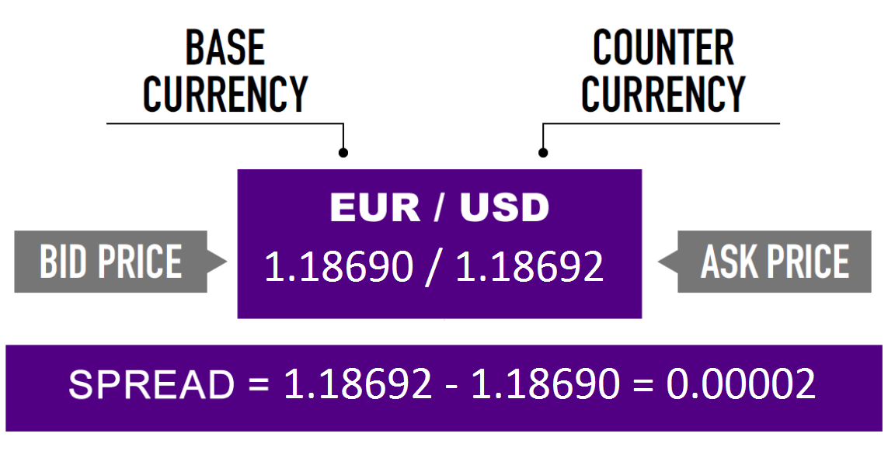
Bid-Ask Spread

Slide 6
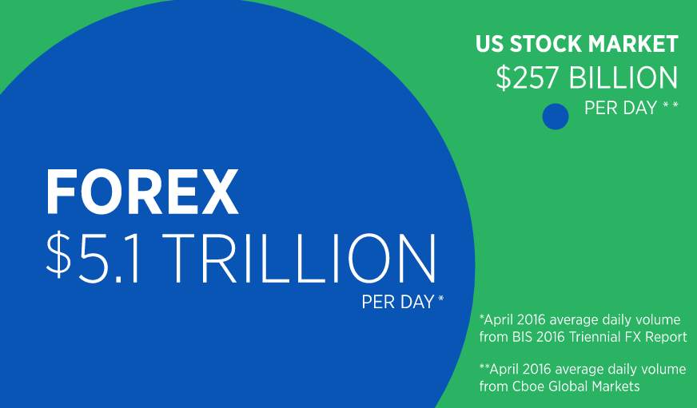
Foreign Exchange Market
Electronic, order driven markets
Orders are matched with the best available offers
Limit orders stay in the book until matched or canceled
Largest Financial Market in the World
1
Two-tier Structure
2
Interbank Trading
Trade between Customers and Bank
Decentralized
3
No official opening or closing time
4
Interbank Trading
Where the Price formation takes place;
Where the Spot Exchange Rate are set;
Trade between Customers and Bank
Customers are the actual end-users of the currencies
They consist of:
Non-dealer financial institutions
Corporations and Governments
http://www.forexmarkethours.com/

Slide 7
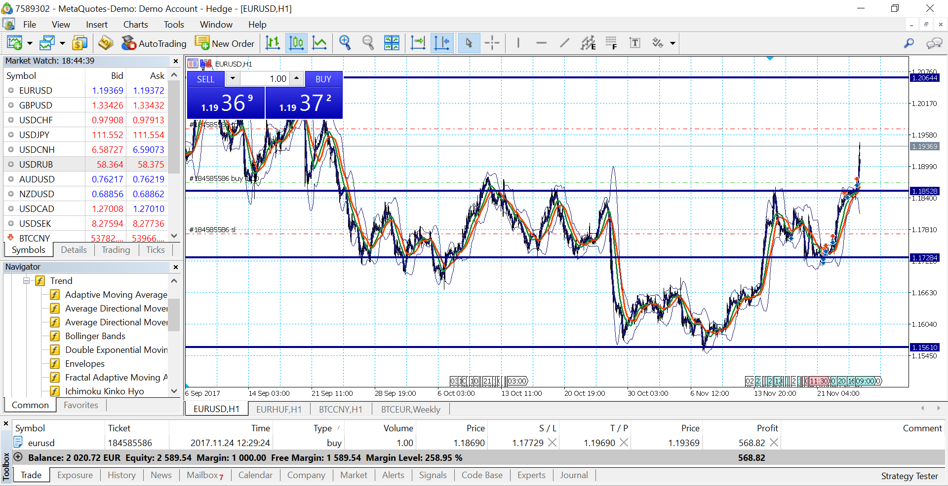
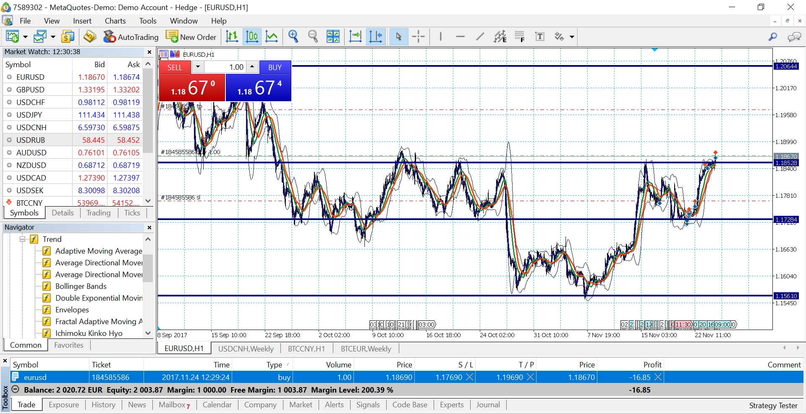
Foreign Exchange Market

Slide 8
Spread Components
Order Processing Costs
Inventory Holding Costs
Adverse Selection costs

Slide 9
The Model

Slide 10
Empirical Elements
Data
Intraday Patterns

Slide 11
Data
All quotes (limit and market orders) on the HUF/EUR interbank market
Complete tick-by-tick dataset for 2003 and 2004
Platform used: Reuters D3000 broking system
Only service for this currency pair during the timeframe – captures all electronic trading

Slide 12
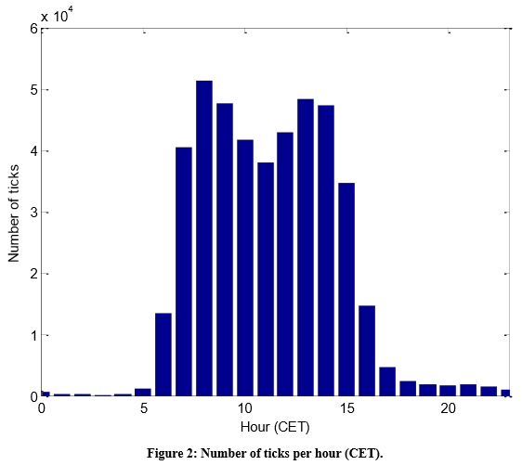
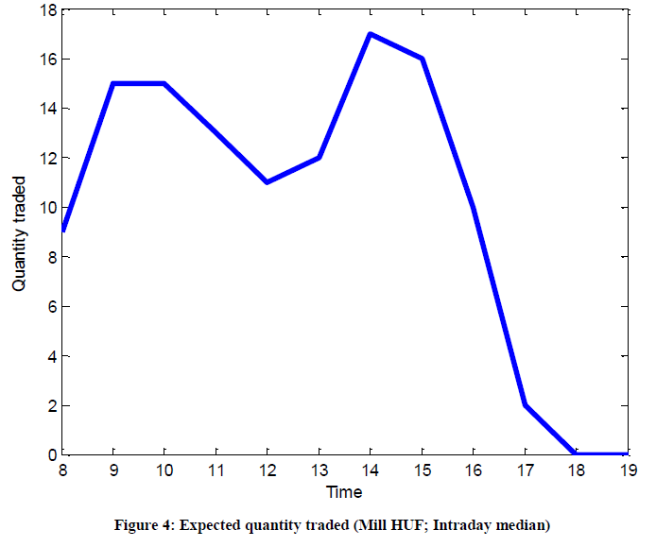
Intraday Patterns - Volume
M-shapped
Consistent with literature

Slide 13
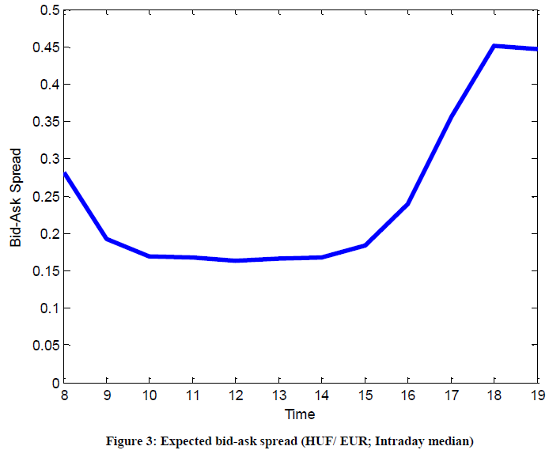
Intraday Patterns - Spread
U-shapped
Also consistent with literature
Mean quoted spread:
Peak times: 0.2305
Non-peak times: 0.5096

Slide 14
Empirical Elements (Results)
Bivariate Correlations
Decomposition Results
Estimate for the number of Liquidity Providers

Slide 15
Bivariate Correlations

Slide 16
Decomposition Results

Slide 17
Number of Liquidity Providers
Varies during the sample period
Higher before the speculative attack

Slide 18
Applications
Peak vs Non-Peak Times

Slide 19
Peak vs Non-Peak Times
+35%
+269%

Slide 20
Speculative Attack
Upward pressure against the FORINT
Expectations by Hedge Funds of band abandonment by Central Bank

Slide 21
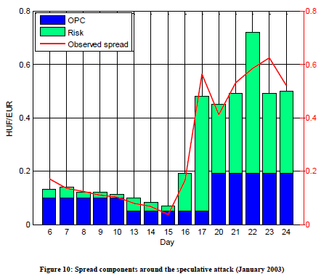
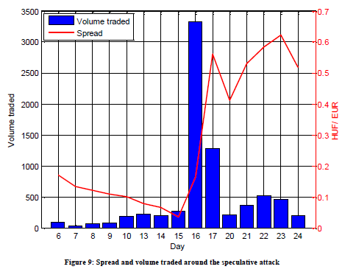
Speculative Attack
Spread and traded volume
Spread components

Slide 22
Possible Exam Questions
What is the decomposition of the spread in the FOREX market? Explain each element in detail.
What is the stylized pattern of "peak" vs "non-peak" time spreads on the FOREX market and where does it stem from?
What is the expected effect a speculative attack has on the spread? Explain.

Slide 23
References
Frömmel, Michael, and F van Gysegem. (2014) “Bid-Ask Spread Components on the Foreign Exchange Market: Quantifying the Risk Component.” (University of Gent 14/878).
Losoncz, Miklós. “Speculative Attack against the Hungarian Forint.” Intereconomics, vol. 38, no. 3, 2003, pp. 132–137., doi:10.1007/bf03031764.
Bjønnes, Geir H., and Dagfinn Rime, 2005, Dealer behavior and trading systems in foreign exchange markets, Journal of Financial Economics 75, 571-605.

